Slide 1

Griffin
Architecture
High Level Design v0.1

Slide 2
Agenda
Business Context
Objective & Scope
High-Level Architecture
Data Model
  Logical Data Model
  Physical Data Model
Integration Architecture (Sequence Diagram)
Workflow & Process
Capability Mapping
Security & Access
NFR
Risks
Assumption & Dependency

Slide 3
Business Context
Vodafone Operating Company (OpCo) wants to govern the Vantage Tower-managed tower inventory
need to ensure that tower assets are accurately recorded for billing and payment
Ensure that tower assets are accurately recorded for billing and payment
provides visibility from order initiation to asset acceptance
must ensure that tower asset commissioning adheres to regulatory and security standards
need to manage the full lifecycle of tower-related service agreements
ensure accurate and timely payments for tower infrastructure
reflect tower-related costs accurately in financial statements
track and reconcile variable tower usage charges
resolve discrepancies in tower-related payments
need visibility into asset, financial, and operational metrics
manage access, roles, and system configurations
need accurate and automated handling of S16 contracts based on inventory status

Slide 4
Objective & Scope
In Scope:
  Supplier master data, supplier product catalog & rates
  Site Agreement/Contract repository (incl. contract line items, specific cost)
  Tower Site Inventory and contract ingestion and reconciliation as per MSA
  maintain the Tower Site Inventory lifecycle
  Integration with Vantage Tower for the Site agreement
  Integration with Vantage Tower for the Billing Invoice
  S16 contract creation in REFX
  Data stewardship for the site agreement
  Monthly invoice ingestion, parsing, and line‑level validation
  Dispute & approval workflow
  Onboarding OpCo Group in SIP
  Reporting & KPIs
Out of Scope (v1):
  Order Journey is not covered in the program
  Any inventory that is installed on the site and its lifecycle
  Individual site assets (like BTS cabinet, switch etc..) costs

Slide 5
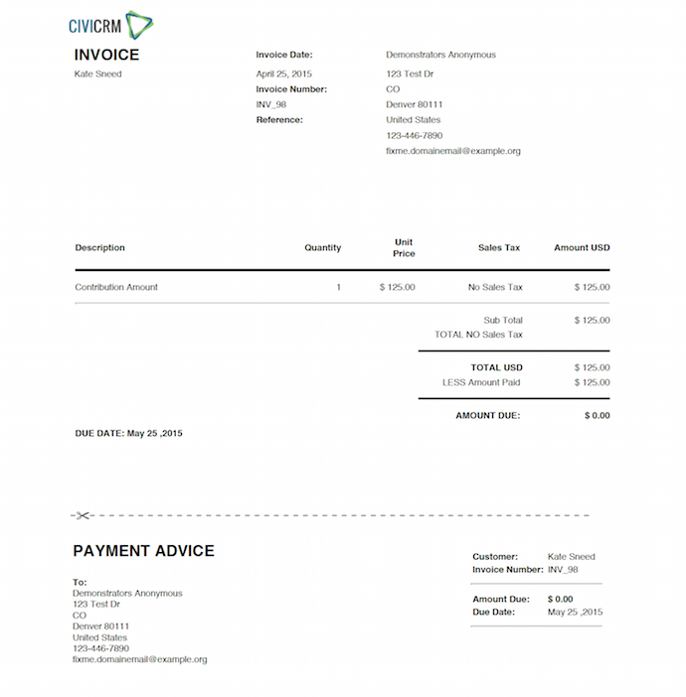

High Level Architecture
Need to Review
DXL
Billing API
Vantage Tower
DXL
Approval / Rejection Update
S
SIP
Invoice (pdf) and line level detail (Excel)
Contract Request API
Attachment API
Staging
1
Case and Product Inventory Creation
Site Agreement
Case
Product Inventory
2
DXL
Approval from OPCO
5
Invoice received/ingested
Approval
Review & Approval
6
Line level data
FinCA
10a
Vendor Asset Management
Accrual exception bucket
Local Market
8
Invoice status¹
DXL
Access SIP Assets and contract
Portal
Tower Site
Report
Contract
10
Accrual generation²
Document Management
9
All invoices posted to EVO
Non-S16 accruals and deferrals only posted to EVO
3
7
Matching Contract
11
Tower Site and Contract, Contract Line Item creation after the approval
DXL
SAP
RE-FX
SAP
EVO
4
S16 monthly postings

Slide 6
Data Model.xlsx
Logical & Physical Data Model
Only to support VSG-6, VSG-7,VSG-8, VSG-9
VSG-8
Supplier
Data Stewardship
MSA
VSG-8
VSG-8
OPCO
Country
Opco Attributes
VSG-9
Case
VSG-8
VSG-7
VSG-6
Supplier Catalog
Tower Site
Location
Approval
VSG-16
VSG-8
VSG-7
Product Offering
Product Inventory
VSG-8
VSG-8
VSG-7
VSG-6
VSG-6
Product Specification
Product
Characteristic
Inventory Characteristics
Contract
Site Contract PDF
VSG-6
VSG-6
VSG-6
Product Model
Characteristic
Contract Line Item
Product Model
VSG-20
REFX Contract

Slide 7
Integration Details – Vantage to SIP Site Agreement Submission(New Provide, Modify, Aggregation)
Vantage
DXL
SIP
HTTPS GET call for the auth token
Responds with Auth Token
HTTPS POST call to create Site contract in SIP
Validate and authenticate client
HTTPS GET call for the auth token
Responds with Auth Token
HTTPS POST call to create Site contract request in SIP
Validate and authenticate client
Success in processing request
Request : Created, Attachment : Available, Approval : Pending
Responds with success message
Responds with success message
Responds with partial success message but attachment missing
Success in processing request
Request : Created, Attachment : Not Available, Approval : Pending
Responds with success message with different code
Failure in processing request
Request : Not Created, Attachment : Not Available, Approval : Not Applicable
Responds with failure message
Responds with failure message
Vantage
DXL
SIP

Slide 8
Integration Details – SIP to Vantage Approval/ Rejection update
WIP
SIP
DXL
Vantage
HTTPS GET call for the auth token
Responds with Auth Token
HTTPS POST to share the Site ID and Approval Status and Comments
Validate and authenticate client
HTTPS GET call for the auth token
Responds with Auth Token
HTTPS POST call to share the site approval to Vantage
Validate and authenticate client
Success in processing request
Comments : Site Approval is Approved or Rejected
Responds with success message
Responds with success message
Failure in processing request
Request : Not Created, Attachment : Not Available, Approval : Not Applicable
Responds with failure message
Responds with failure message
SIP
DXL
Vantage

Slide 9
Capability & Application Mapping
Epic No | Capability Jira No | Capability Details | Status | VT | DXL | SIP | FINCA | REFX
VSG-2 | VSG-6 | Creating a Record That Allows for Payment | Analysis | Y | Y | Y
VSG-2 | VSG-7 | Create Technical Components That Record a Created Asset | Analysis | Y | Y | Y
VSG-2 | VSG-8 | Reference Data - Capture and Manage | Analysis | Y |  | Y
VSG-2 | VSG-9 | Asset Creation Approval Workflow | Not Started | Y |  | Y
VSG-3 | VSG-10 | Contract Lifecycle Change – Managed Services Ag | Not Started | Y | Y | Y |  | Y
VSG-3 | VSG-11 | Cease and Decommissioning of Assets | Not Started | Y | Y | Y |  | Y
VSG-3 | VSG-12 | Move, Adds, and Changes of Individual Assets | Not Started | Y | Y | Y |  | Y
VSG-4 | VSG-13 | Paying for Towers | Not Started | Y | Y | Y | Y
VSG-4 | VSG-14 | Accounting for Towers | Not Started |  |  | Y | Y | Y
VSG-4 | VSG-15 | Record Variable Costs (Usage of Monthly Variable Charging) | Not Started | Y |  | Y
VSG-4 | VSG-16 | Exception Handling (Data Stewardship) | Not Started |  |  | Y
VSG-4 | VSG-17 | Dispute Resolution of Payments | Not Started | Y | Y | Y | Y
VSG-4 | VSG-18 | Reporting | Not Started |  |  | Y
VSG-4 | VSG-19 | User and System Management | Not Started |  |  | Y
VSG-4 | VSG-20 | ReFX Integration | Not Started |  | Y | Y |  | Y

Slide 10
Security & Access

Slide 11
NFR

Slide 12
Assumption & Dependency

Slide 13
NFR

Slide 14
Data Model.xlsx
Logical & Physical Data Model
VSG-8
Supplier
VSG-16
VSG-8
VSG-8
Data Stewardship
MSA
OPCO
Country
VSG-9
Case
VSG-8
VSG-7
VSG-6
Supplier Catalog
Tower Site
Location
Approval
VSG-16
VSG-8
VSG-7
VSG-6
Product Offering
Product Inventory
Site Contract PDF
Invoice
VSG-13,14
VSG-8
VSG-8
VSG-7
VSG-6
Product Specification
Product
Characteristic
Inventory Characteristics
Contract
Invoice
Line Item
VSG-13,14
VSG-6
VSG-6
VSG-6
Product Model
Characteristic
Contract Line Item
VSG-17
Product Model
Invoice
Discrepancy Case
REFX Contract
VSG-20

